Slide 1
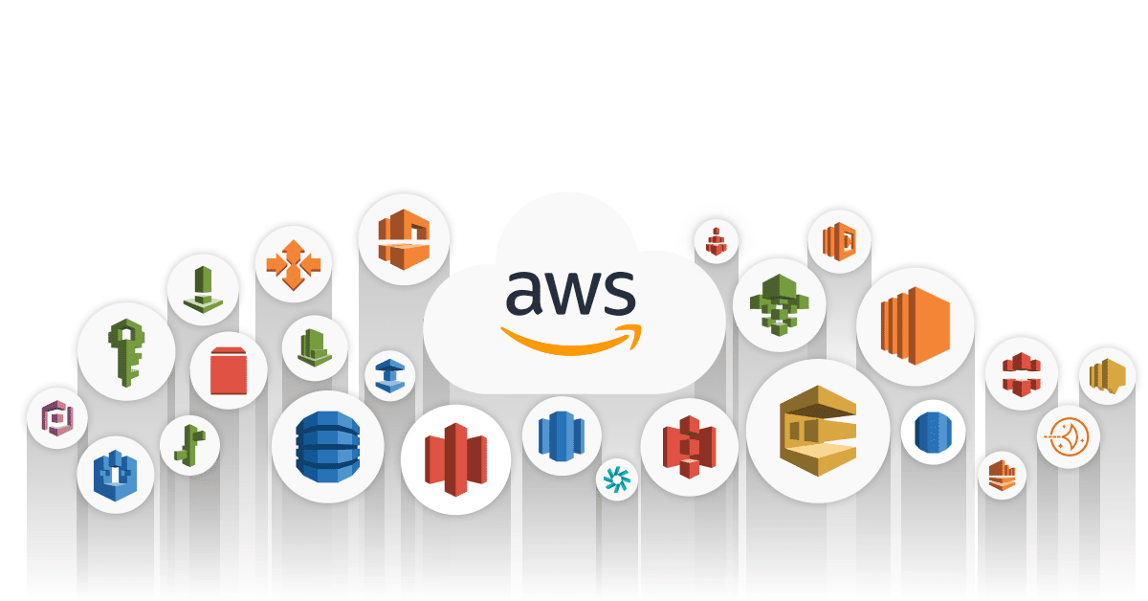
AWS Services Overview

Slide 2


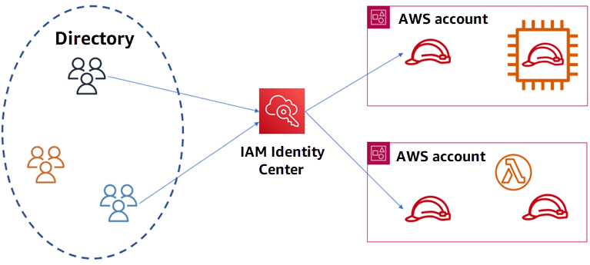





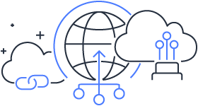
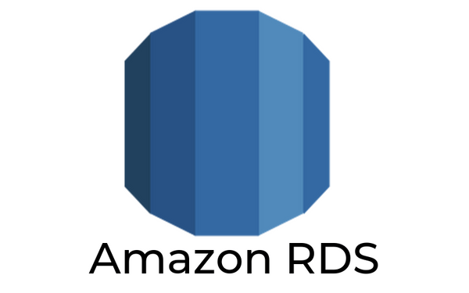
Overview _ what we will cover ?
User Management
Compute
Storage
EC2
AMI
EFS
S3
EBS
Databases
Networking
DynamoDB
Notes:
Welcome to an immersive journey through the realms of web technology, virtualization, and the revolutionary cloud computing
We have a packed agenda ahead, designed to provide you with a holistic understanding of these interconnected domains
"Prepare to immerse yourself in a comprehensive exploration, designed to empower you with knowledge and skills for the digital future
Demystifying Websites:
"Kickstarting our journey with a deep dive into the mechanics of websites, unraveling how they function and connect us in the digital space."
Virtualization Unleashed:
"Exploring the magic behind virtualization, its types, and the tangible benefits virtual machines bring to the table."
Historical Insights & Challenges:
"Stepping back in time to the Dot-com Boom, understanding the growing complexities in IT, and dissecting the problems with traditional IT approaches."
Cloud Computing Decoded:
"Defining cloud computing, exploring its key characteristics, types, and the pricing dynamics that shape the cloud landscape."
Shared Responsibilities & AWS Insights:
"Diving into the shared responsibility model, deciphering Amazon’s pioneering role in cloud computing, and exploring AWS’s global infrastructure."
Navigating AWS & Cloud Best Practices:
"Guiding you through choosing the right AWS region, understanding edge locations, and adopting AWS Well-Architected Pillars for optimal cloud usage."
*****************************************************************
Web Wisdom:
"Master the fundamentals of how websites work, gaining insights into the digital threads that weave the World Wide Web."
Virtualization Virtuosity:
"Develop a deep understanding of virtualization, its various forms, and the transformative benefits of virtual machines."
Historical Context and IT Evolution:
"Acquire a historical perspective with the Dot-com Boom, understand the complexities of traditional IT, and identify the pitfalls of past practices."
Cloud Computing Mastery:
"Demystify cloud computing, delve into its key characteristics, types, and pricing models, transforming the way you perceive and interact with the cloud."
Shared Responsibility and AWS Expertise:
"Grasp the concept of shared responsibility in cloud security and gain exclusive insights into Amazon’s journey and leadership in cloud services."
Navigating AWS and Architecting Excellence:
"Learn how to strategically select AWS regions, understand the significance of edge locations, and adopt best practices with AWS Well-Architected Pillars."

Slide 3
AWS User Management
AWS Identity & Access Management
2

Slide 4
Learning objectives
Explain the benefits of the shared responsibility model.
Describe multi-factor authentication (MFA).
Differentiate between the AWS Identity and Access Management (IAM) security levels.
Explain the main benefits of AWS Organizations.
Describe security policies at a basic level.
Summarize the benefits of compliance with AWS.
Explain additional AWS security services at a basic level.

Slide 5
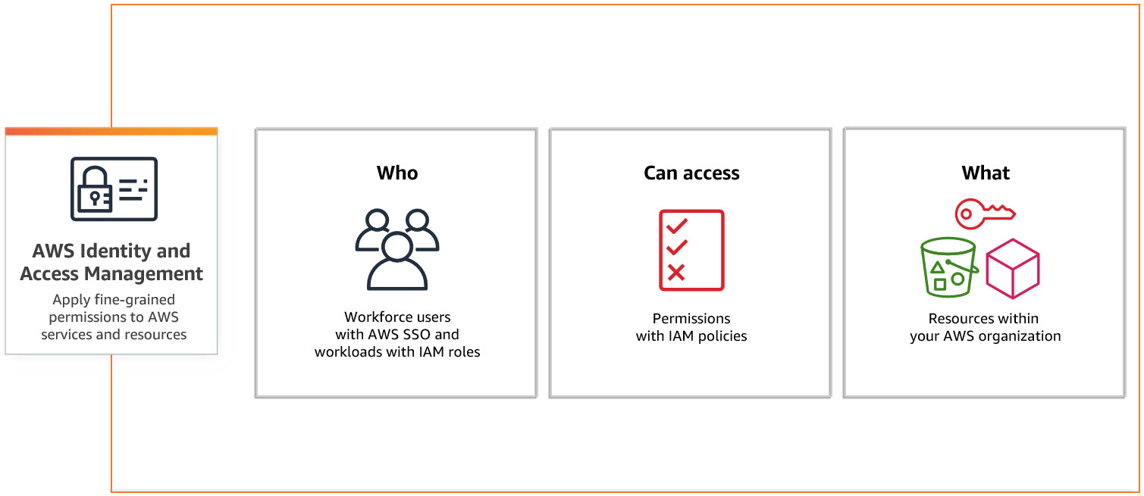
AWS Identity & Access Management

Slide 6
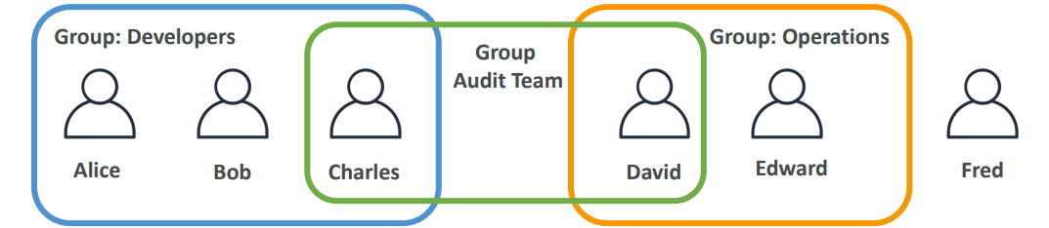
IAM: Users & Groups
Root account created by default, shouldn’t be used or shared
Users are people within your organization, and can be grouped
Groups only contain users, not other groups
Users don’t have to belong to a group, and user can belong to multiple groups

Slide 7
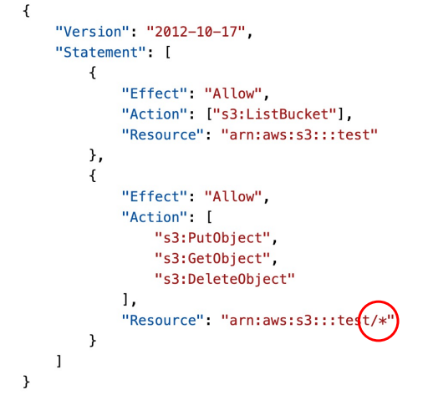
IAM Permissions for S3
• s3:ListBucket permission applies to
arn:aws:s3:::test
=> bucket level permission
• s3:GetObject, s3:PutObject, s3:DeleteObject applies to arn:aws:s3:::test/*
=> object level permission
Notes:
• Some AWS service will need to
perform actions on your behalf
• To do so, we will assign
permissions to AWS services
with IAM Roles

Slide 8
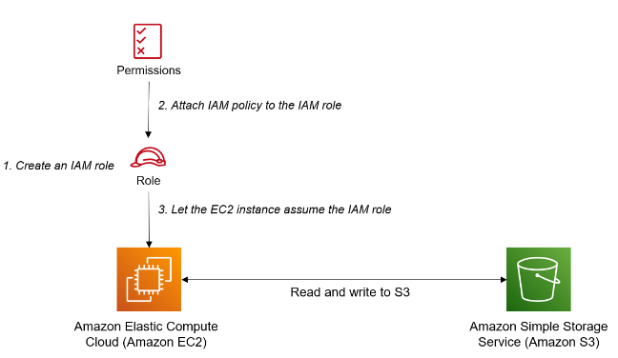
How IAM Policies Work ?
{
"Version": "2012-10-17",
"Statement": [
{
"Effect": "Allow",
"Action": "s3:*",
"Resource": [
"arn:aws:s3:::example-bucket",
"arn:aws:s3:::example-bucket/*"
]
}
]
}
Notes:
• Some AWS service will need to
perform actions on your behalf
• To do so, we will assign
permissions to AWS services
with IAM Roles

Slide 9
Example IAM Policy
{
"Version": "2012-10-17",
"Statement": [
{
"Effect": "Deny",
"Action": "sqs:*",
"Resource": “*”
},
{
"Effect": "Allow",
"Action": ["sqs:DeleteQueue"],
"Resource": “*”
}
]
}
Can you perform sqs:CreateQueue?
Can you perform sqs:DeleteQueue?
Can you perform ec2:DescribeInstances?
Notes:
• Some AWS service will need to
perform actions on your behalf
• To do so, we will assign
permissions to AWS services
with IAM Roles

Slide 10
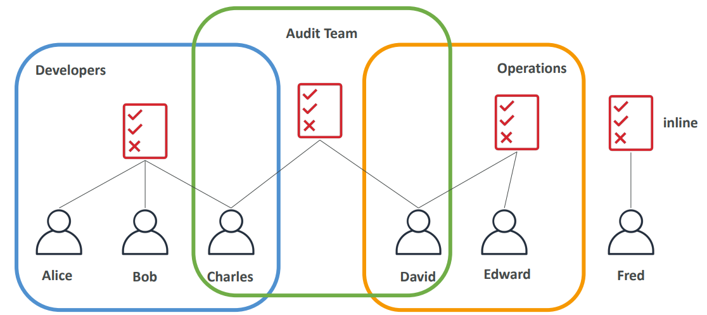
IAM Policies inheritance

Slide 11
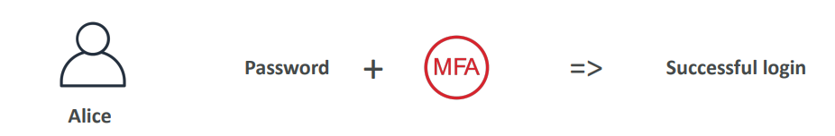
Multi Factor Authentication - MFA
Users have access to your account and can possibly change configurations or delete resources in your AWS account
• You want to protect your Root Accounts and IAM users
• MFA = password you know + security device you own
Main benefit of MFA: If a password is stolen or hacked, the account is not compromised

Slide 12
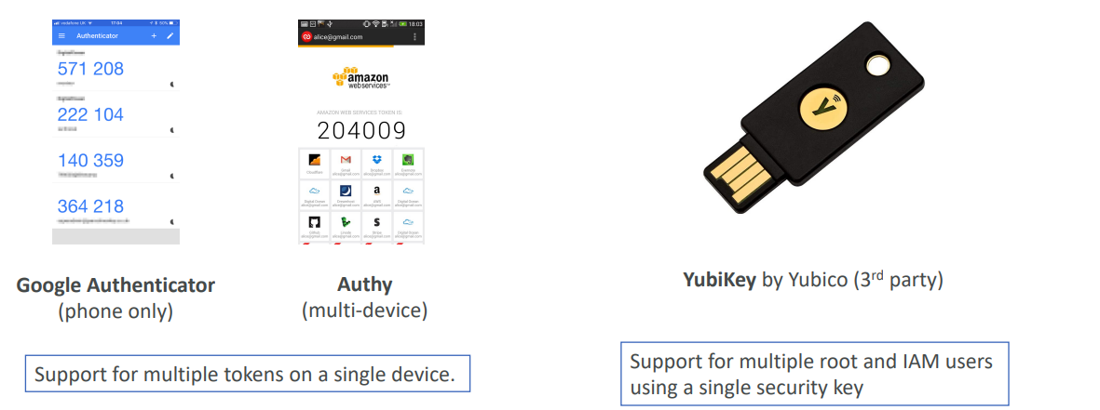
MFA devices options in AWS
Virtual MFA device
Universal 2nd Factor (U2F) Security Key

Slide 13
How can users access AWS ?
To access AWS, you have three options:
AWS Management Console (protected by password + MFA)
AWS Command Line Interface (CLI): protected by access keys
AWS Software Developer Kit (SDK) - for code: protected by access keys
Access Keys are generated through the AWS Console
Access Key ID ~= username
Secret Access Key ~= password

Slide 14
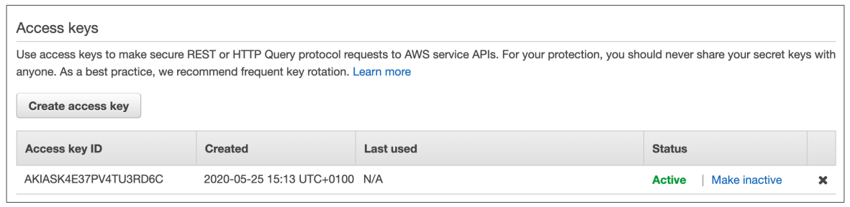
Example (Fake) Access Keys
Access key ID: AKIASK4E37PV4983d6C
Secret Access Key: AZPN3zojWozWCndIjhB0Unh8239a1bzbzO5fqqkZq
Remember: don’t share your access keys

Slide 15
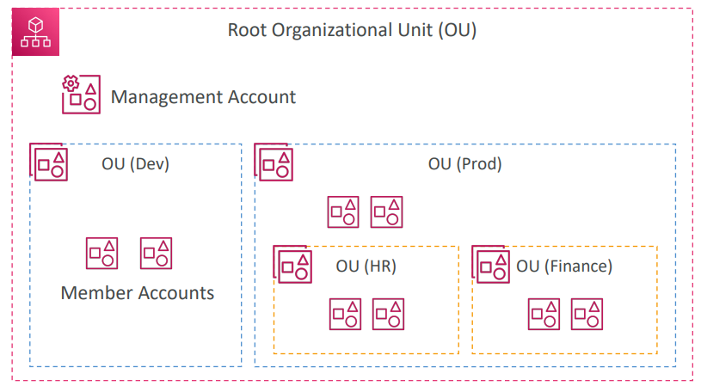
AWS Organizations
Notes:
IAM Credentials Report (account-level)
a report that lists all your account's users and the status of their various
credentials

Slide 16

AWS Organizations
Global service
Allows to manage multiple AWS accounts
The main account is the management account
Other accounts are member accounts
Member accounts can only be part of one organization
Consolidated Billing across all accounts - single payment method
Pricing benefits from aggregated usage (volume discount for EC2, S3…)
Shared reserved instances and Savings Plans discounts across accounts
API is available to automate AWS account creation
Notes:
IAM Credentials Report (account-level)
a report that lists all your account's users and the status of their various
credentials

Slide 17
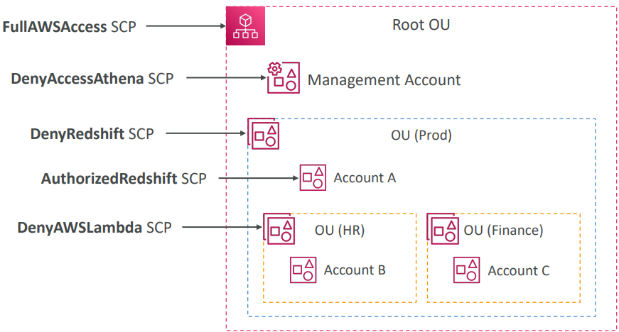
Service Control Policies (SCP) Hierarchy
• Management Account •
Can do anything • (no SCP apply)
• Account A •
Can do anything
• EXCEPT access Redshift (explicit Deny from OU)
• Account B •
Can do anything
• EXCEPT access Redshift (explicit Deny from Prod OU)
• EXCEPT access Lambda (explicit Deny from HR OU)
• Account C •
Can do anything
• EXCEPT access Redshift (explicit Deny from Prod OU)

Slide 18
IAM Guidelines & Best Practices
Don’t use the root account except for AWS account setup
One physical user = One AWS user
Assign users to groups and assign permissions to groups
Create a strong password policy
Use and enforce the use of Multi Factor Authentication (MFA)
Create and use Roles for giving permissions to AWS services
Use Access Keys for Programmatic Access (CLI / SDK)
Never create Access Key and Access Secret Key for the root user.
Never share IAM users & Access Keys

Slide 19

IAM Section – Summary
Users: mapped to a physical user, has a password for AWS Console
Groups: contains users only
Policies: JSON document that outlines permissions for users or groups
Roles: for EC2 instances or AWS services
Security: MFA + Password Policy
Access Keys: access AWS using the CLI or SDK
Audit: IAM Credential Reports & IAM Access Advisor

Slide 20
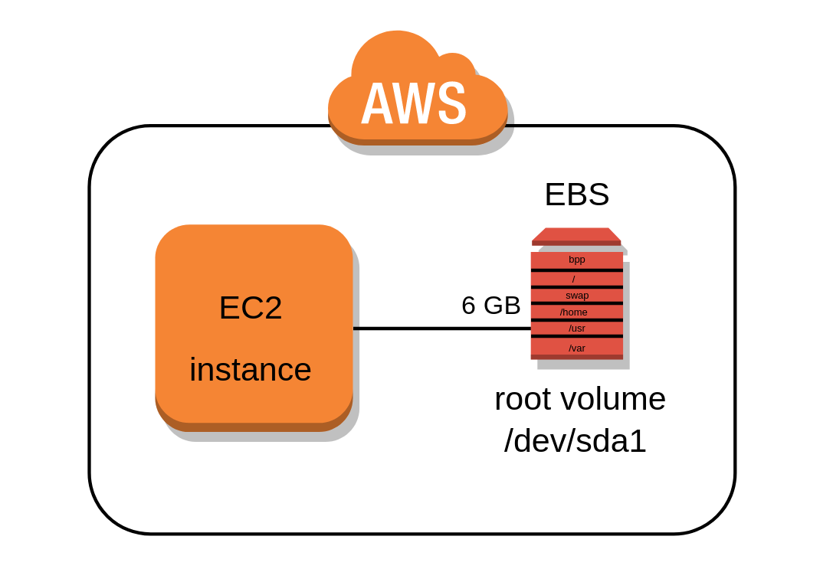
AWS Compute services
Amazon elastic compute cloud

Slide 21
Amazon Elastic Compute Cloud (EC2)
EC2 = Elastic Compute Cloud = Infrastructure as a Service
EC2 is an virtual machine where you can deploy the web applications.
Knowing EC2 is fundamental to understand how the Cloud works
It mainly consists in the capability of :
• Renting virtual machines (EC2) with different configurations
• Web Hosting: Hosting websites and web applications.
• Data Processing: Running large scale data processing jobs.
• Backup and Storage: Using EC2 in combination with other AWS
services for data backup and storage.
Scalability: Easily scale up or down based on demand.
Cost-Effective: Pay only for the compute time used.
Notes:
EC2 is fundamental to understand how the Cloud works

Slide 22
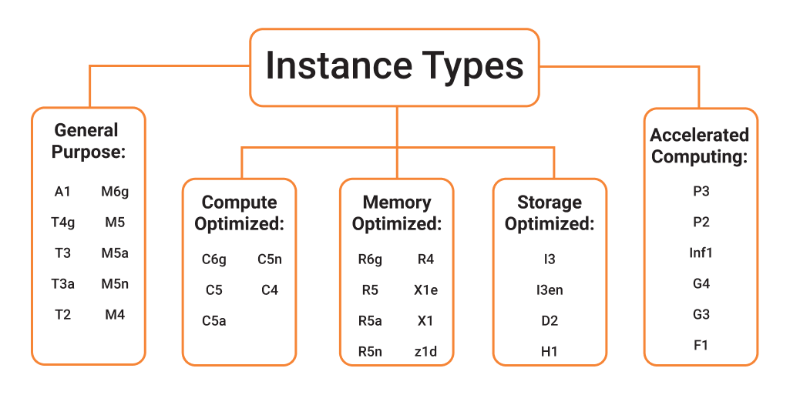
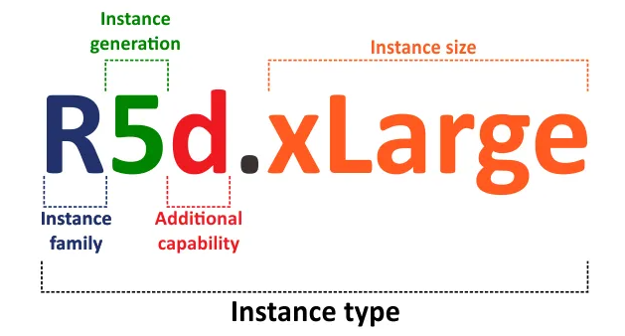
EC2 sizing & configuration options
Sizing an EC2 instance involves choosing the right combination of CPU, memory, storage, and networking capacity for your application's needs.
Notes:
EC2 is fundamental to understand how the Cloud works

Slide 23
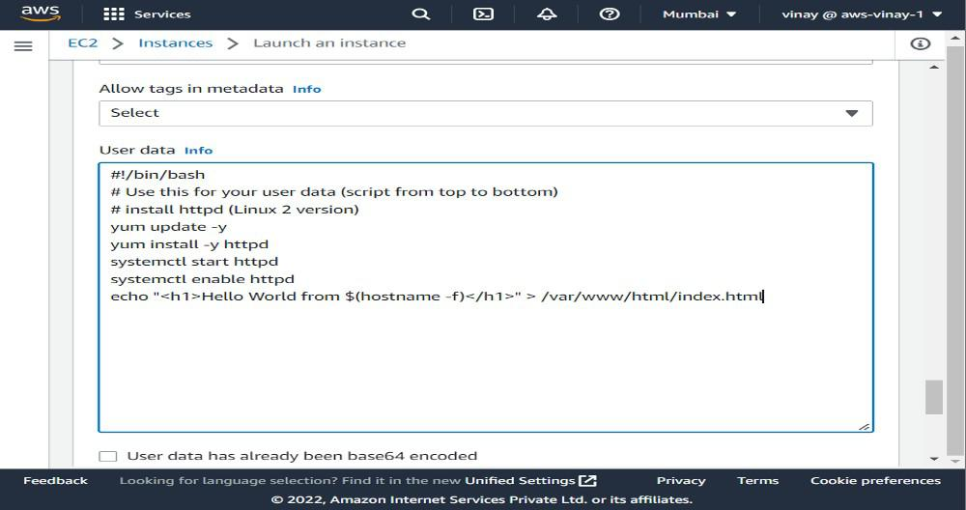
EC2 User Data
EC2 user data is used to automate boot tasks such as:
• Installing updates
• Installing software
• Downloading common files from the internet
• Anything you can think of
bootstrapping means launching commands when a machine starts
• That script is only run once at the instance first start
Notes:
EC2 is fundamental to understand how the Cloud works

Slide 24
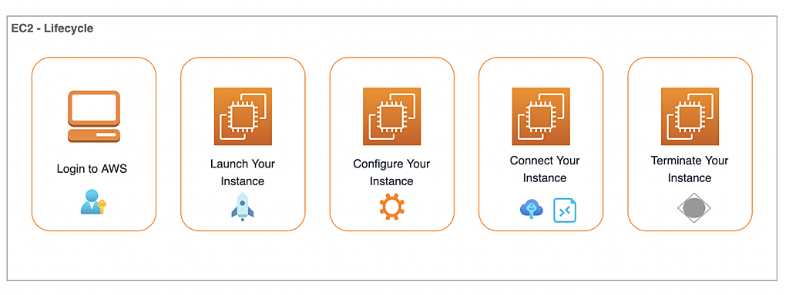
Hands-On: Launching an EC2 Instance running Linux
We’ll be launching our first virtual server using the AWS Console
We’ll get a first high-level approach to the various parameters
We’ll see that our web server is launched using EC2 user data
We’ll learn how to start / stop / terminate our instance.
Notes:
EC2 is fundamental to understand how the Cloud works

Slide 25
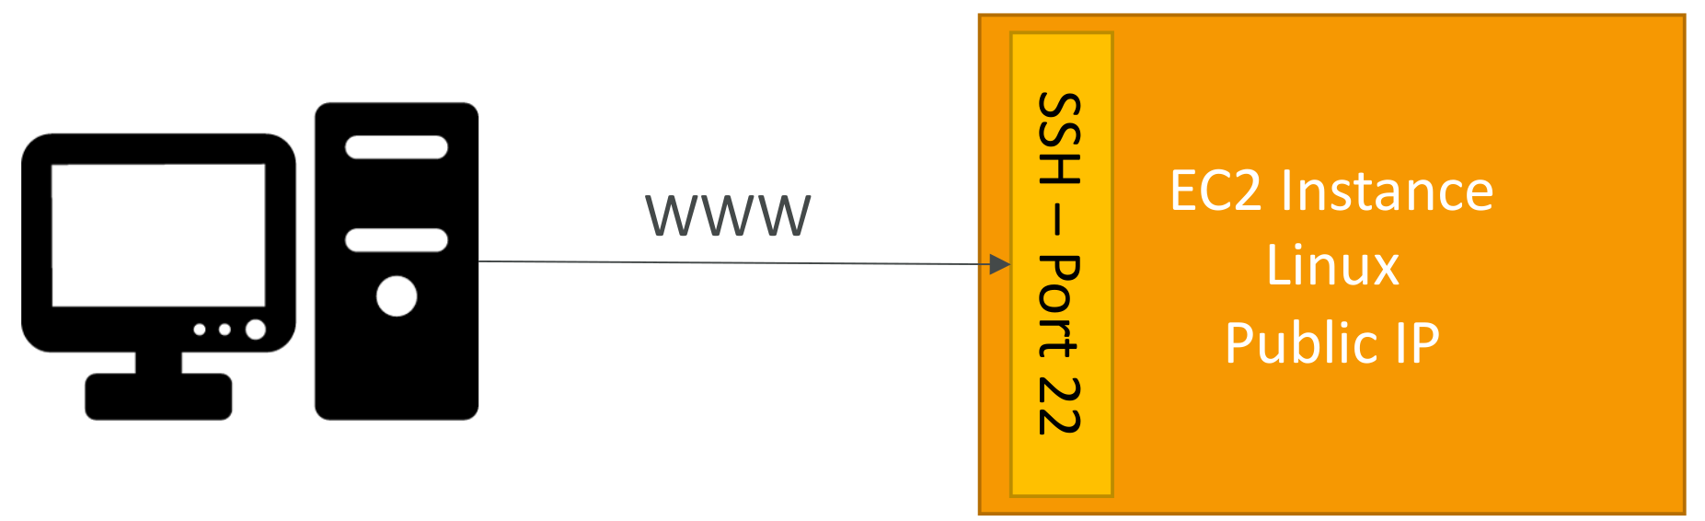
How to SSH into your EC2 Instance
SSH is one of the most important function. It allows you to control a remote machine, all using the command line.
We will see how we can configure OpenSSH ~/.ssh/config to facilitate the SSH into our EC2 instances
Notes:
EC2 is fundamental to understand how the Cloud works

Slide 26
EC2 Hibernate
We know we can stop, terminate instances
• Stop – the data on disk (EBS) is kept intact in the next start
• Terminate – any EBS volumes (root) also set-up to be destroyed is lost
On start, the following happens:
• First start: the OS boots & the EC2 User Data script is run
• Following starts: the OS boots up
• Then your application starts, caches get warmed up, and that can take time!
An instance can NOT be hibernated more than 60 days
Instance Size – not supported for bare metal instances.
Instance RAM Size – must be less than 150 GB.
Available for On-Demand, Reserved and Spot Instances
Notes:
EC2 is fundamental to understand how the Cloud works

Slide 27
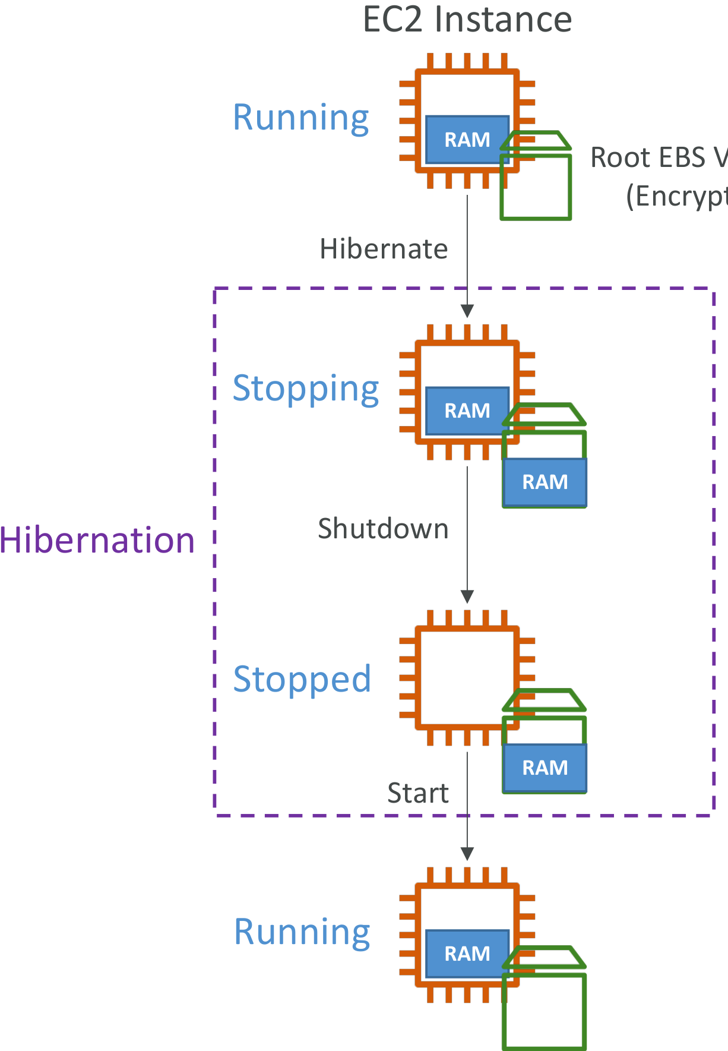
EC2 Hibernate
Root EBS Volume (Encrypted )
Introducing EC2 Hibernate:
• The in-memory (RAM) state is preserved
• The instance boot is much faster!
(the OS is not stopped / restarted)
• Under the hood: the RAM state is written
to a file in the root EBS volume
• The root EBS volume must be encrypted
Use cases:
• Long-running processing
• Saving the RAM state
• Services that take time to initialize
Notes:
EC2 is fundamental to understand how the Cloud works

Slide 28
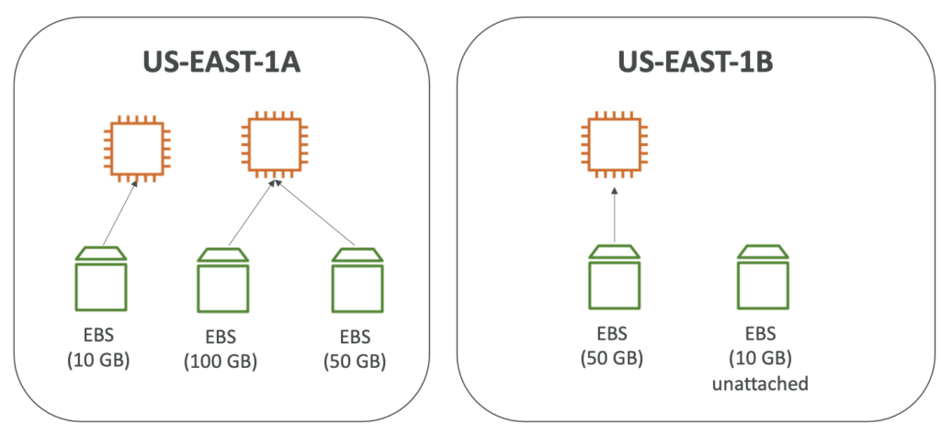
Amazon EC2 – Instance Storage (EBS)
• An EBS (Elastic Block Store) Volume is a network drive you can attach
to your instances while they run
• It allows your instances to persist data, even after their termination
• They can only be mounted to one instance at a time (at the CCP level)
• They are bound to a specific availability zone
• Analogy: Think of them as a “network USB stick”
• Free tier: 30 GB of free EBS storage of type General
Purpose (SSD) or Magnetic per month .
• An EBS Volume in us-east-1a cannot be attached to us-east-1b
• You can increase the capacity of the drive over time
Notes:
EC2 is fundamental to understand how the Cloud works

Slide 29
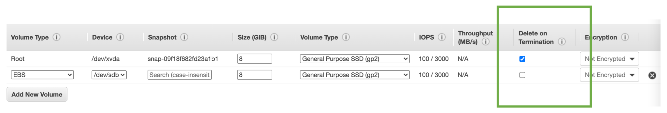
EBS – Delete on Termination attribute
Controls the EBS behaviour when an EC2 instance terminates
By default, the root EBS volume is deleted (attribute enabled)
By default, any other attached EBS volume is not deleted (attribute disabled)
This can be controlled by the AWS console / AWS CLI
Use case: preserve root volume when instance is terminated
Notes:
EC2 is fundamental to understand how the Cloud works

Slide 30
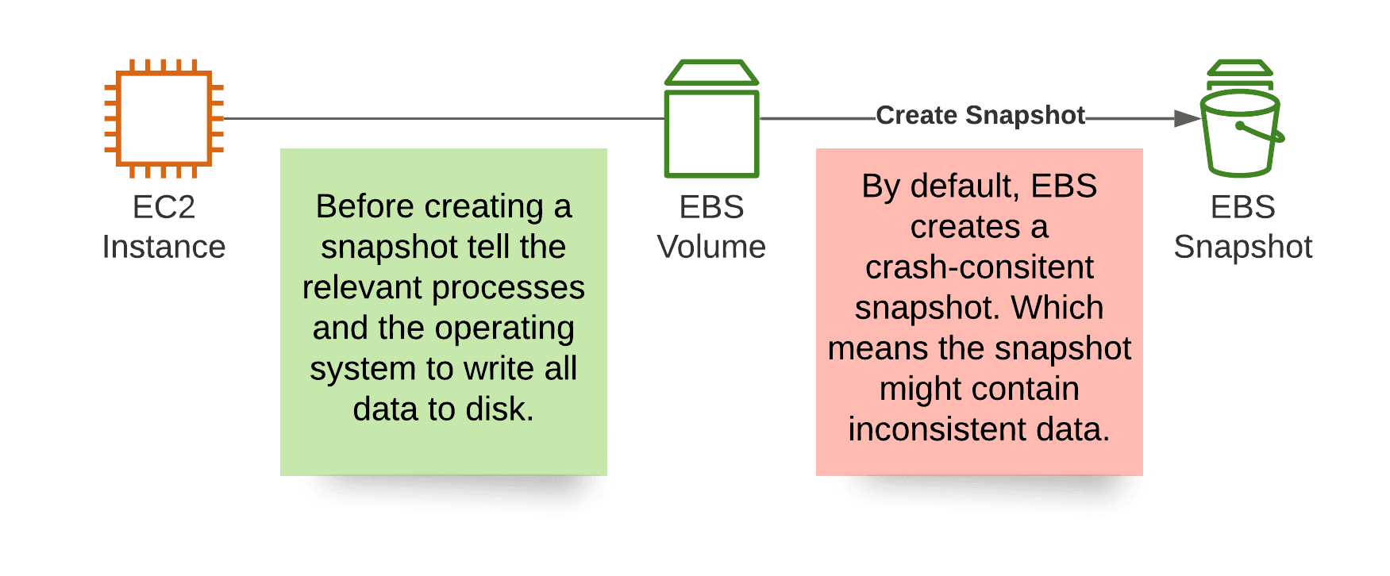
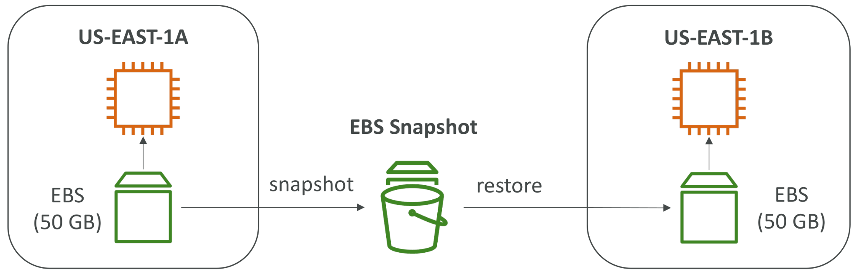
EBS Snapshots
Make a backup (snapshot) of your EBS volume at a point in time
Not necessary to detach volume to do snapshot, but recommended
Can copy snapshots across AZ or Region

Slide 31

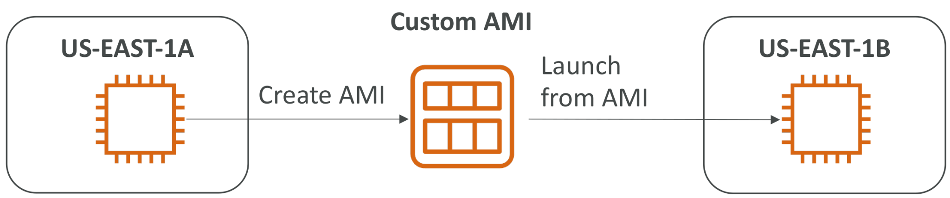
Amazon Machine Image (AMI) Overview
AMI are a customization of an EC2 instance
• You add your own software, configuration, operating system, monitoring…
• Faster boot / configuration time because all your software is pre-packaged
• AMI are built for a specific region (and can be copied across regions)
• You can launch EC2 instances from:
• A Public AMI: AWS provided
• Your own AMI: you make and maintain them yourself
• An AWS Marketplace AMI: an AMI someone else made (and potentially sells)
Notes:
EC2 is fundamental to understand how the Cloud works

Slide 32
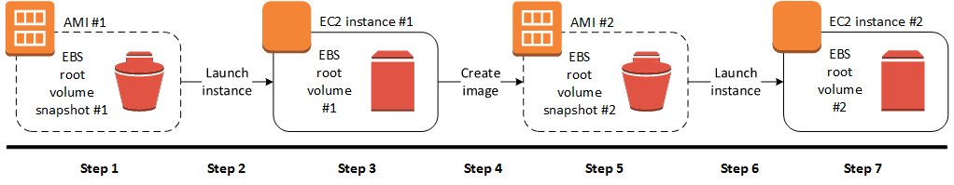
AMI Process (from an EC2 instance)
Launch an EC2 instance to use as the basis for the AMI.
Customize the instance by installing software and making configuration changes.
Stop the instance to ensure data consistency when creating a snapshot.
Create a snapshot of the instance's root volume. **
Create an AMI based on the snapshot, specifying the name and description.
Launch instances from the AMI with the same configuration as the original instance.
Notes:
Start an EC2 instance and customize it
• Stop the instance (for data integrity)
• Build an AMI – this will also create EBS snapshots
• Launch instances from other AMIs

Slide 33
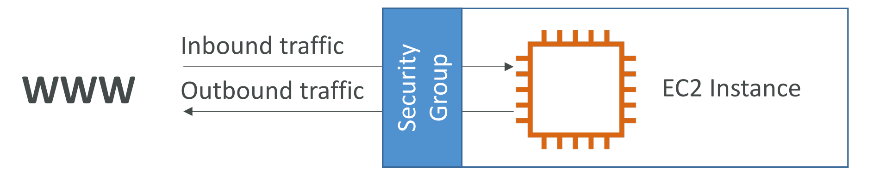
Introduction to Security Groups
Security Groups are the fundamental of network security in AWS acting as a “firewall” on EC2 instances
They control how traffic is allowed into or out of our EC2 Instances.
All inbound traffic is blocked by default
All outbound traffic is authorised by default
Security groups only contain allow rules
Security groups rules can reference by IP or by security group
They regulate: Access to Ports , Authorised IP ranges – IPv4 and IPv6 , Control of inbound network (from other to the instance) and Control of outbound network (from the instance to other)
Notes:
EC2 is fundamental to understand how the Cloud works

Slide 34
Classic Ports to know
22 = SSH (Secure Shell) - log into a Linux instance
21 = FTP (File Transfer Protocol) – upload files into a file share
22 = SFTP (Secure File Transfer Protocol) – upload files using SSH
80 = HTTP – access unsecured websites
443 = HTTPS – access secured websites
3389 = RDP (Remote Desktop Protocol) – log into a Windows instance
Notes:
EC2 is fundamental to understand how the Cloud works

Slide 35
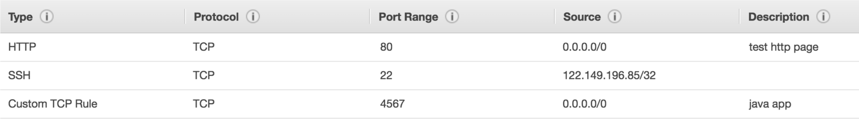
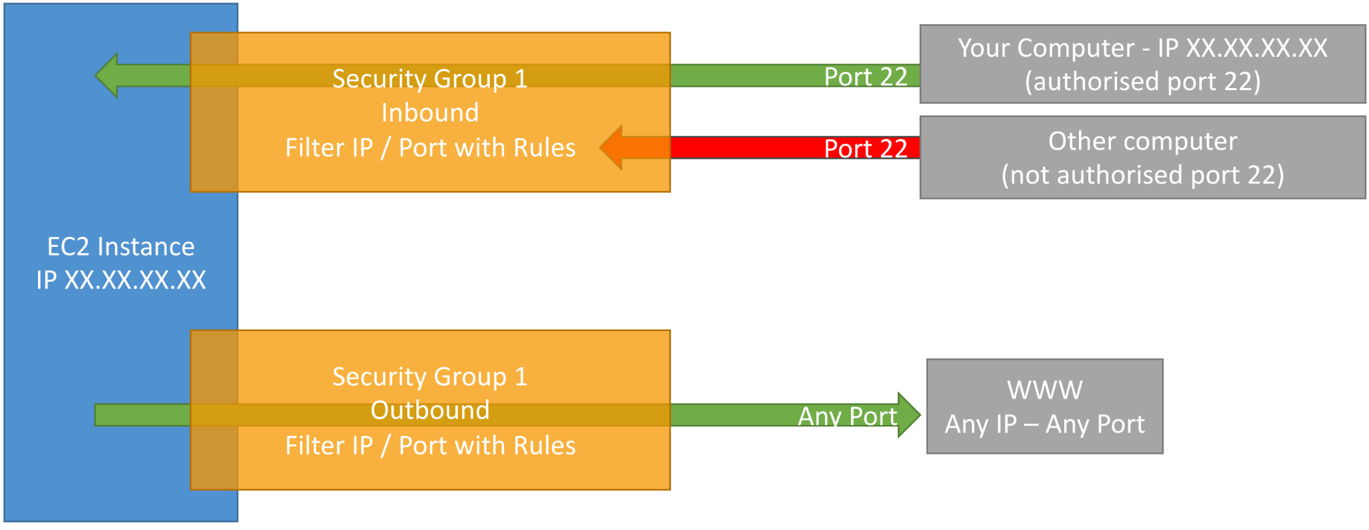
Security Groups Diagrams
Notes:
EC2 is fundamental to understand how the Cloud works

Slide 36
Private vs Public IP (IPv4)
Networking has two sorts of IPs. IPv4 and IPv6:
IPv4: 1.160.10.240
IPv6: 3ffe:1900:4545:3:200:f8ff:fe21:67cf
In this course, we will only be using IPv4.
IPv4 is still the most common format used online.
IPv6 is newer and solves problems for the Internet of Things (IoT).
IPv4 allows for 3.7 billion different addresses in the public space
IPv4: [0-255].[0-255].[0-255].[0-255].
Notes:
EC2 is fundamental to understand how the Cloud works

Slide 37
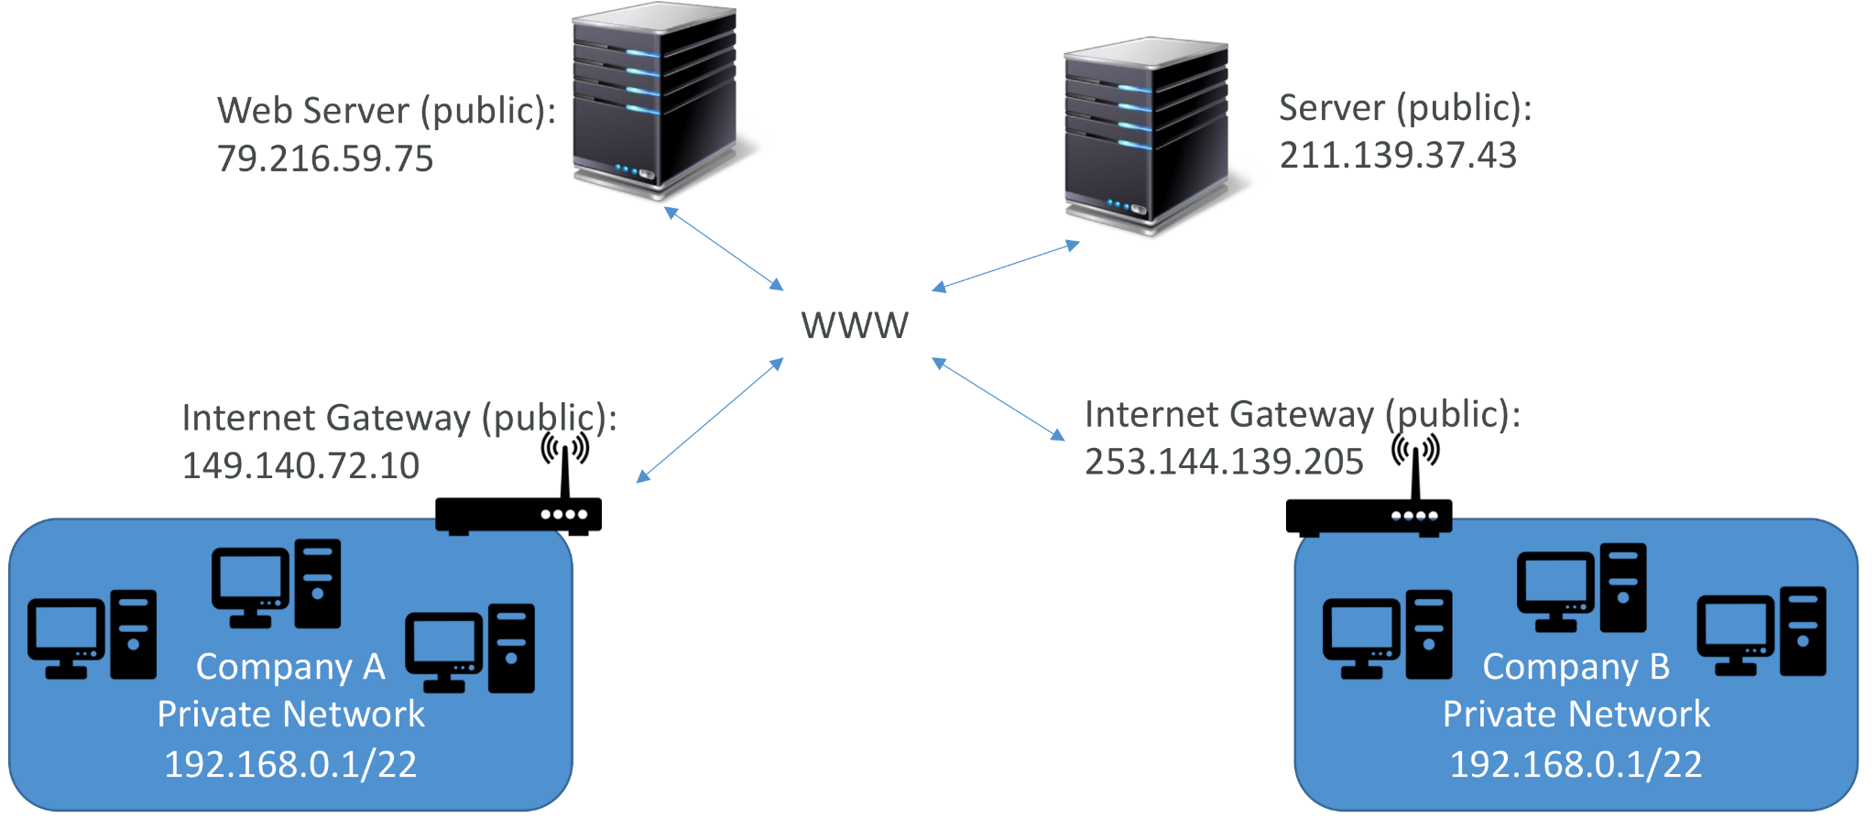
Private vs Public IP (IPv4) Example
Notes:
EC2 is fundamental to understand how the Cloud works

Slide 38
Private vs Public IP (IPv4) Fundamental Differences
Public IP:
• Public IP means the machine can be identified on the internet (WWW)
• Must be unique across the whole web (not two machines can have the same public IP).
• Can be geo-located easily
Private IP:
• Private IP means the machine can only be identified on a private network only
• The IP must be unique across the private network
• BUT two different private networks (two companies) can have the same IPs.
• Machines connect to WWW using a NAT + internet gateway (a proxy)
• Only a specified range of IPs can be used as private IP
Notes:
EC2 is fundamental to understand how the Cloud works

Slide 39
Private vs Public IP (IPv4) Fundamental Differences
By default, your EC2 machine comes with:
• A private IP for the internal AWS Network
• A public IP, for the WWW.
When we are doing SSH into our EC2 machines:
• We can’t use a private IP, because we are not in the same network
• We can only use the public IP.
If your machine is stopped and then started, the public IP can change
Notes:
EC2 is fundamental to understand how the Cloud works

Slide 40
Elastic IPs
When you stop and then start an EC2 instance, it can change its public IP.
If you need to have a fixed public IP for your instance, you need an Elastic IP
An Elastic IP is a public IPv4 IP you own as long as you don’t delete it
You can attach it to one instance at a time
With an Elastic IP address, you can mask the failure of an instance or software by rapidly remapping the address to another instance in your account.
You can only have 5 Elastic IP in your account (you can ask AWS to increase that).
Overall, try to avoid using Elastic IP:
• They often reflect poor architectural decisions
• Instead, use a random public IP and register a DNS name to it
• Or, as we’ll see later, use a Load Balancer and don’t use a public IP
Notes:
EC2 is fundamental to understand how the Cloud works

Slide 41
AWS Storage services
Elastic file system
File level storage
Amazon S3
Object level storage
Elastic block store
Block level storage

Slide 42
What’s an EBS Volume?
An EBS (Elastic Block Store) Volume is a network drive you can attach to your instances while they run
It allows your instances to persist data, even after their termination
They can only be mounted to one instance at a time (at the CCP level)
They are bound to a specific availability zone
Analogy: Think of them as a “network USB stick”
Free tier: 30 GB of free EBS storage of type General Purpose (SSD) or Magnetic per month
It’s a network drive (i.e. not a physical drive)
It uses the network to communicate the instance, which means there might be a bit of latency
It can be detached from an EC2 instance and attached to another one quickly

Slide 43
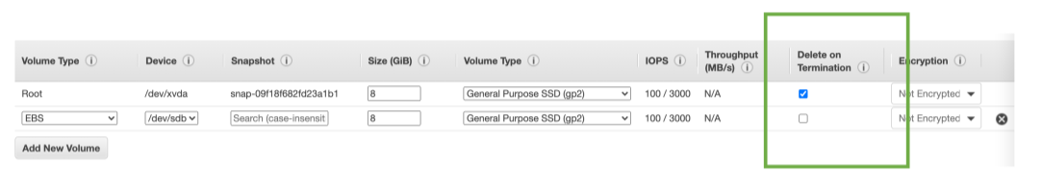
EBS – Delete on Termination attribute
Controls the EBS behaviour when an EC2 instance terminates
By default, the root EBS volume is deleted (attribute enabled)
By default, any other attached EBS volume is not deleted (attribute disabled)
This can be controlled by the AWS console / AWS CLI
Use case: preserve root volume when instance is terminated

Slide 44
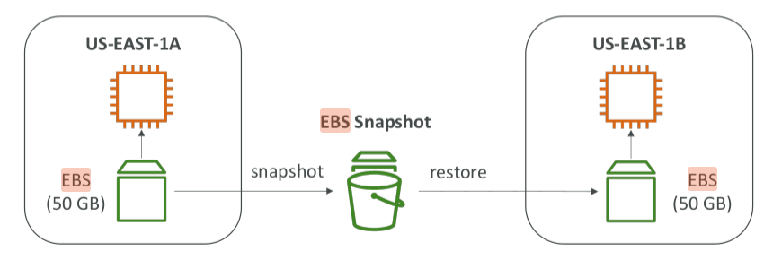
EBS Snapshots
Make a backup (snapshot) of your EBS volume at a point in time
Not necessary to detach volume to do snapshot, but recommended
Can copy snapshots across AZ or Region

Slide 45
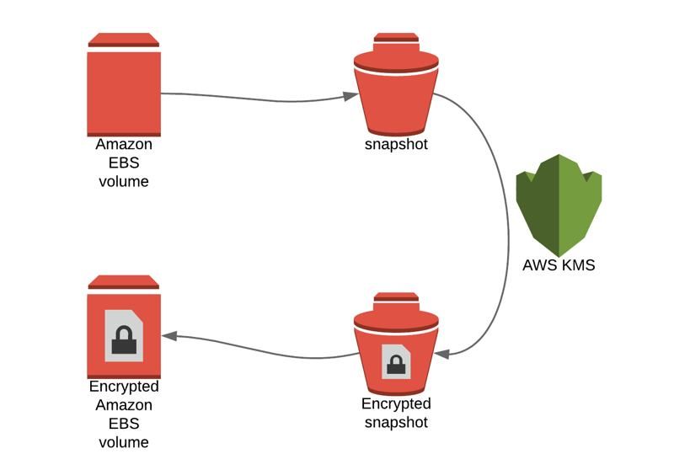
EBS Encryption
• When you create an encrypted EBS volume, you get the following:
• Data at rest is encrypted inside the volume
• All the data in flight moving between the instance and the volume is encrypted
• All snapshots are encrypted
• All volumes created from the snapshot
• Encryption and decryption are handled transparently (you have nothing to do)
• Encryption has a minimal impact on latency
• EBS Encryption leverages keys from KM (AES-256)
• Copying an unencrypted snapshot allows encryption
• Snapshots of encrypted volumes are encrypted
Notes:
• Create an EBS snapshot of the volume
• Encrypt the EBS snapshot ( using copy )
• Create new ebs volume from the snapshot ( the volume will also be
encrypted )
• Now you can attach the encrypted volume to the original instance

Slide 46
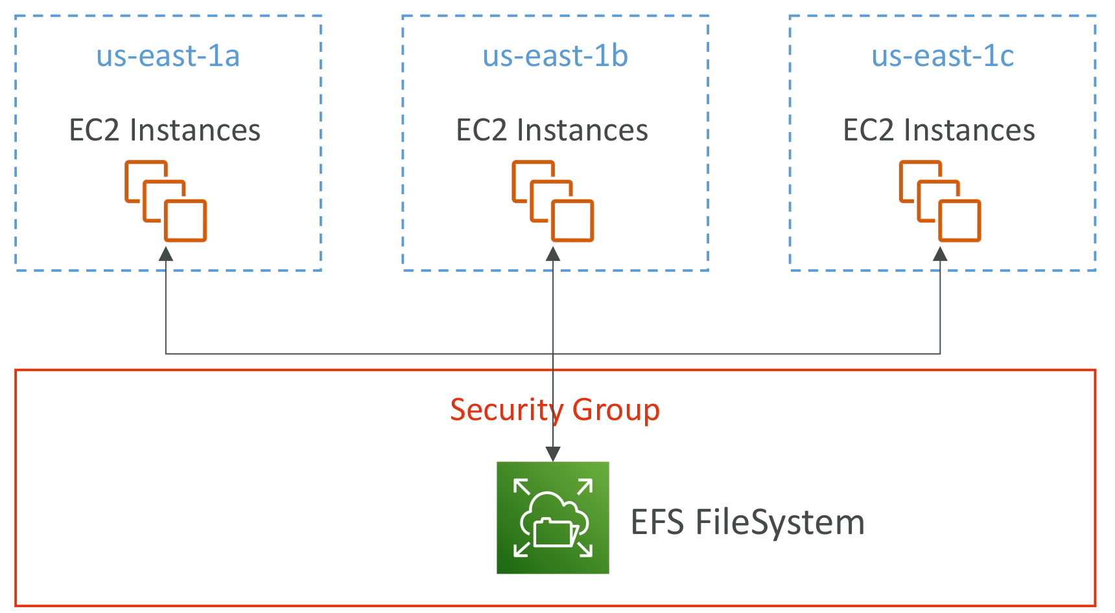
Amazon EFS – Elastic File System
Managed NFS (network file system) that can be mounted on many EC2
Highly available, scalable, expensive (3x gp2), pay per use
EFS works with EC2 instances in multi-AZ

Slide 47
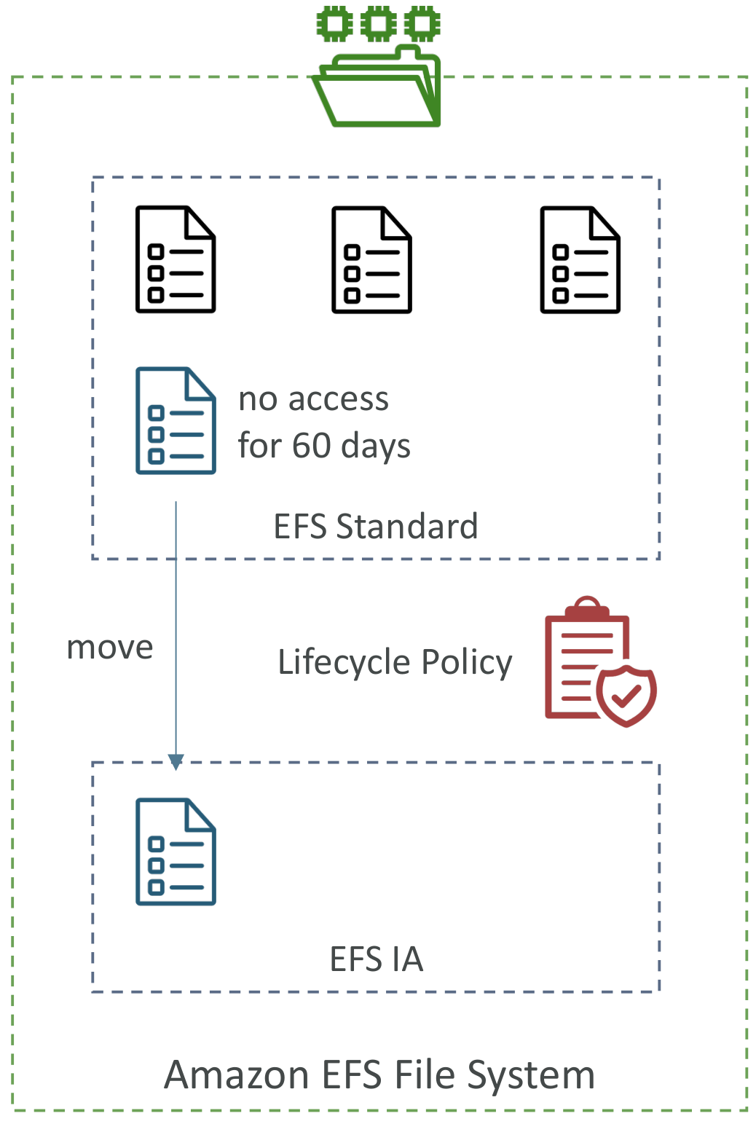
EFS – Storage Classes
Storage Tiers (lifecycle management feature– move file after N days)
• Standard: for frequently accessed files
• Infrequent access (EFS-IA): cost to retrieve files, lower price to store. Enable EFS-IA with a Lifecycle Policy
Availability and durability
• Standard: Multi-AZ, great for prod
• One Zone: One AZ, great for dev, backup enabled by default, compatible with IA (EFS One Zone-IA)
Over 90% in cost savings

Slide 48
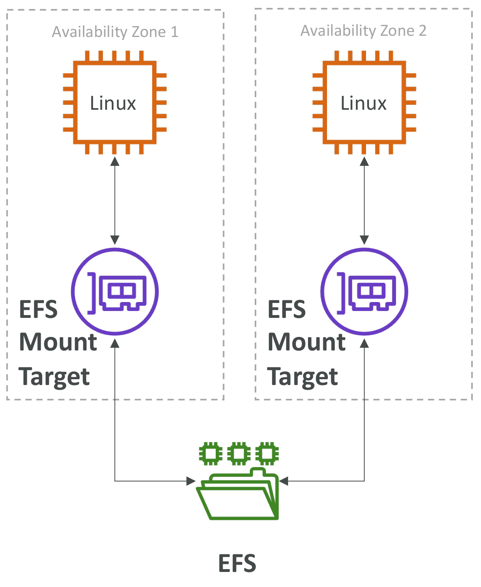
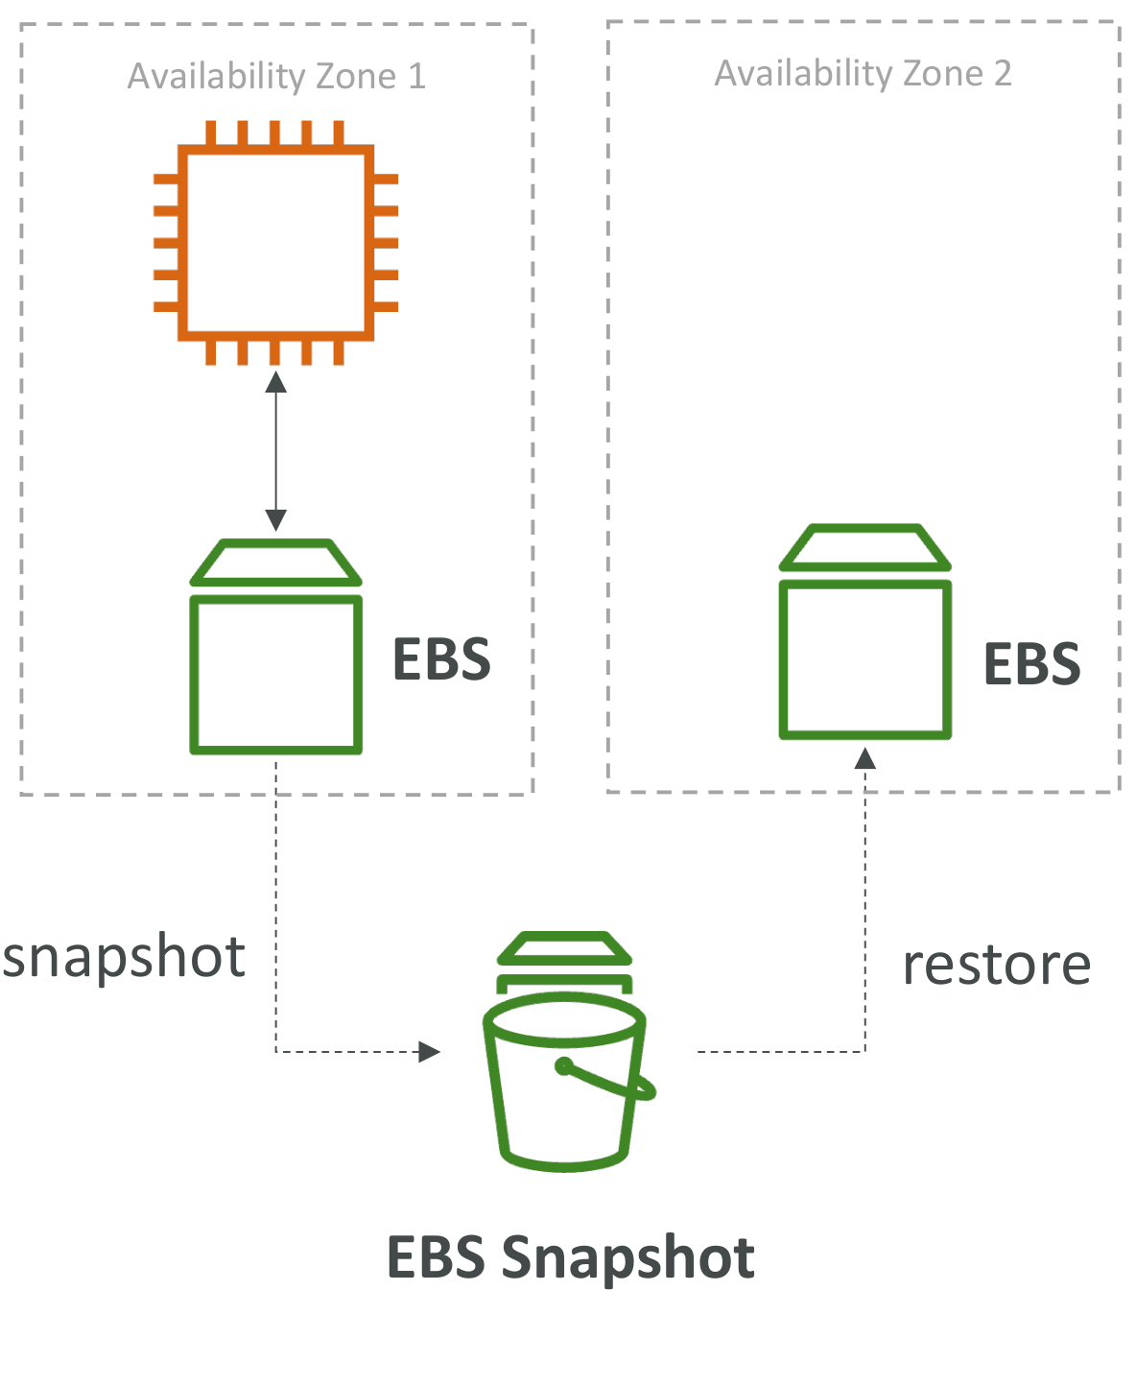
EBS vs EFS – Elastic Block Storage

Slide 49
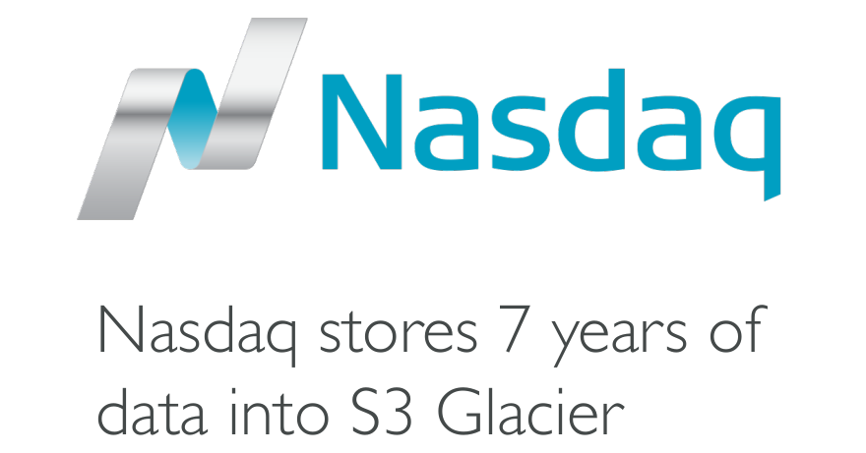
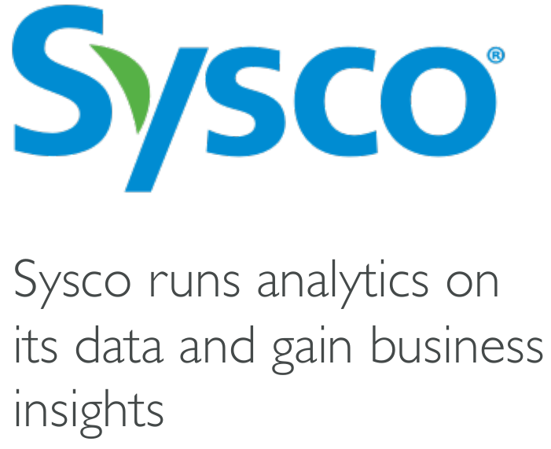
Amazon Simple Storage Service (S3)
• Amazon S3 is one of the main building blocks of AWS
• It’s advertised as ”infinitely scaling” storage
• Many websites use Amazon S3 as a backbone
• Many AWS services use Amazon S3 as an integration as well
Amazon S3 Use cases • Backup and storage
• Disaster Recovery
• Archive
• Hybrid Cloud storage
• Application hosting
• Media hosting
• Data lakes & big data analytics
• Software delivery
• Static website

Slide 50
Amazon S3 - Buckets
• Amazon S3 allows people to store objects (files) in “buckets” (directories)
• Buckets must have a globally unique name (across all regions all accounts)
• Buckets are defined at the region level
• S3 looks like a global service but buckets are created in a region
• Naming convention
• No uppercase, No underscore
• 3-63 characters long
• Not an IP
• Must start with lowercase letter or number
• Must NOT start with the prefix xn--
• Must NOT end with the suffix -s3alias

Slide 51
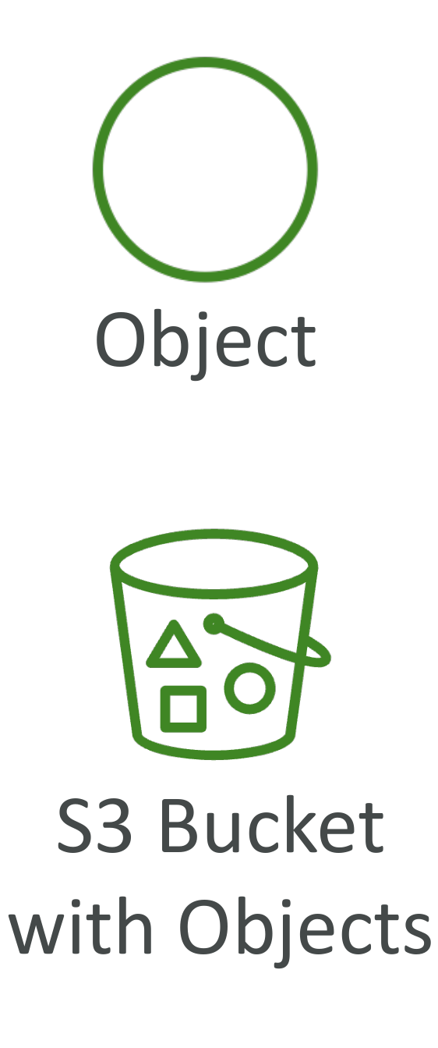
Amazon S3 - Objects
• Objects (files) have a Key
• The key is the FULL path:
• s3://my-bucket/my_file.txt
• s3://my-bucket/my_folder1/another_folder/my_file.txt
• The key is composed of prefix + object name
• s3://my-bucket/my_folder1/another_folder/my_file.txt
• There’s no concept of “directories” within buckets
(although the UI will trick you to think otherwise)
• Just keys with very long names that contain slashes (“/”)

Slide 52
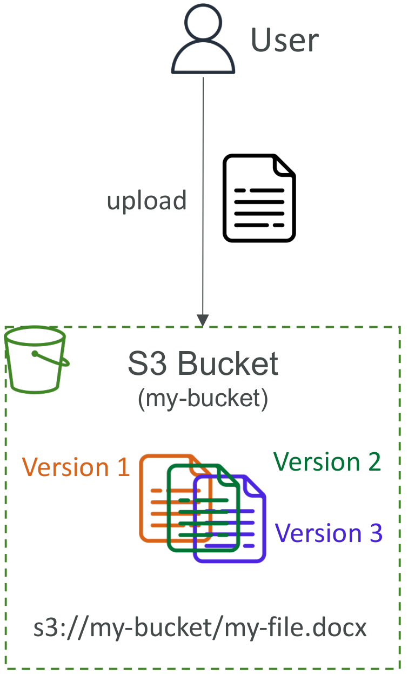
Amazon S3 - Versioning
• You can version your files in Amazon S3
• It is enabled at the bucket level
• Same key overwrite will change the “version”: 1, 2, 3….
• It is best practice to version your buckets
• Protect against unintended deletes (ability to restore a version)
• Easy roll back to previous version
• Notes:
• Any file that is not versioned prior to enabling versioning will have version “null”
• Suspending versioning does not delete the previous versions

Slide 53
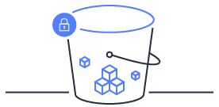
Amazon S3 – Security
• User-Based
• IAM Policies – which API calls should be allowed for a specific user from IAM
• Resource-Based
• Bucket Policies – bucket wide rules from the S3 console - allows cross account
• Object Access Control List (ACL) – finer grain (can be disabled)
• Bucket Access Control List (ACL) – less common (can be disabled)
• Note: an IAM principal can access an S3 object if
• The user IAM permissions ALLOW it OR the resource policy ALLOWS it
• AND there’s no explicit DENY
• Encryption: encrypt objects in Amazon S3 using encryption keys

Slide 54
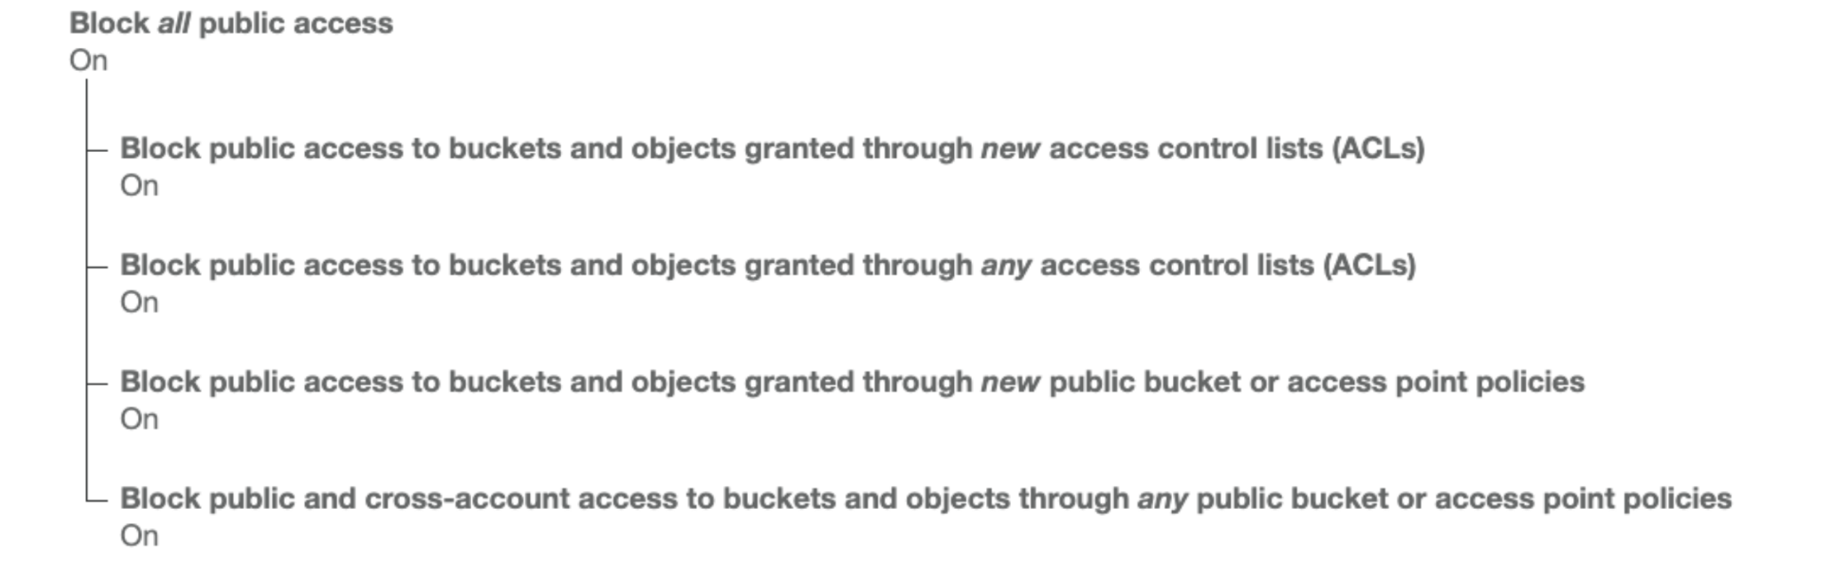
Bucket settings for Block Public Access
• These settings were created to prevent company data leaks
• If you know your bucket should never be public, leave these on
• Can be set at the account level

Slide 55
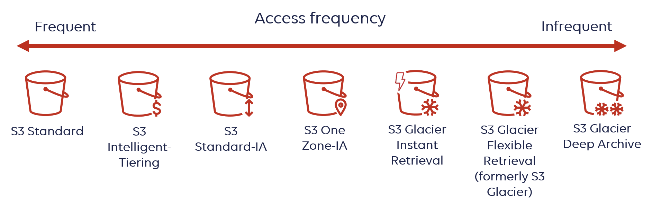
S3 Storage Classes
• Used for frequently accessed data
• Low latency and high throughput
• Sustain 2 concurrent facility failures
• Use Cases: Big Data analytics, mobile & gaming applications, content
distribution…
designed to optimize storage costs by automatically moving data to the most cost-effective access tier as access patterns change
• For data that is less frequently accessed, but requires rapid access when needed
• Lower cost than S3 Standard
• Low-cost object storage meant for archiving / backup
• Pricing: price for storage + object retrieval cost
Disaster Recovery, backups
Storing secondary backup copies of on-premises data, or data you can recreate
Minimum storage duration of 90 days
Minimum storage duration of 90 days
Minimum storage duration of 180 days

Slide 56

AWS Databases services
RDS
DynamoDB

Slide 57
Databases & Shared Responsibility on AWS
AWS offers use to manage different databases
Benefits include:
Quick Provisioning, High Availability, Vertical and Horizontal Scaling
Automated Backup & Restore, Operations, Upgrades
Operating System Patching is handled by AWS
Monitoring, alerting
Note: many databases technologies could be run on EC2, but you must handle yourself the resiliency, backup, patching, high availability, fault tolerance, scaling…

Slide 58
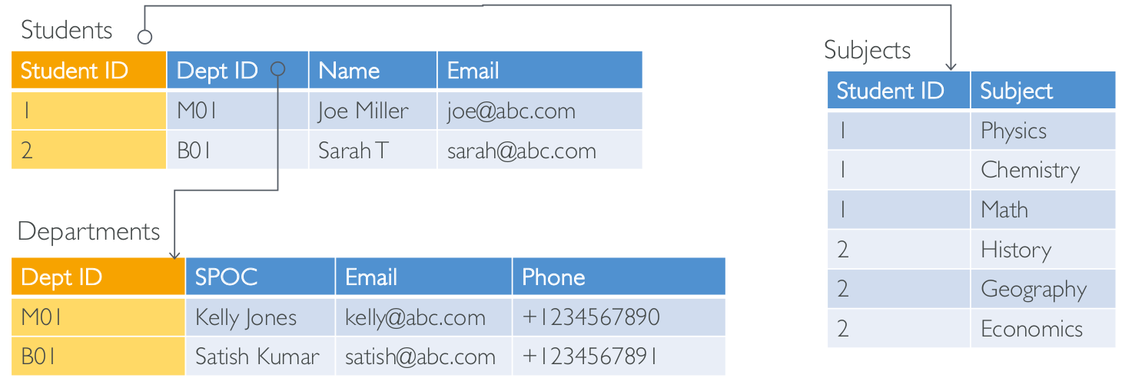
Relational Databases
Looks just like Excel spreadsheets, with links between them!
Can use the SQL language to perform queries / lookups

Slide 59
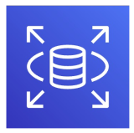
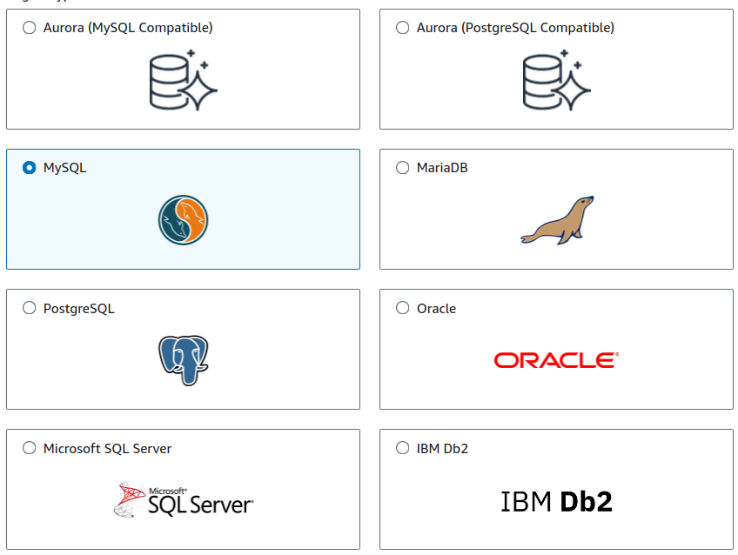
AWS RDS Overview
RDS stands for Relational Database Service
It’s a managed DB service for DB use SQL as a query language.
It allows you to create databases in the cloud that are managed by AWS
Postgres
MySQL
MariaDB
Oracle
Microsoft SQL Server
Aurora (AWS Proprietary database)

Slide 60
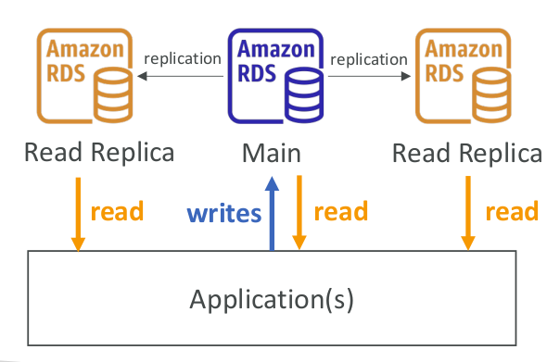
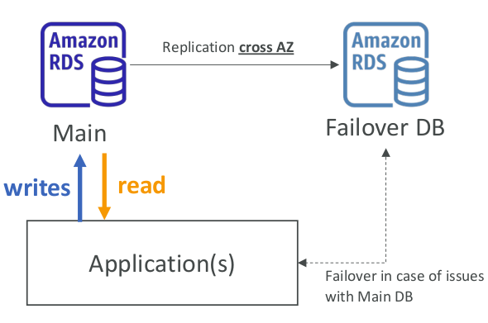
RDS Deployments: Read Replicas, Multi-AZ
Read Replicas:
Multi-AZ:
Scale the read workload of your DB
Can create up to 15 Read Replicas
Data is only written to the main DB
Failover in case of AZ outage (high availability)
Data is only read/written to the main database
Can only have 1 other AZ as failover

Slide 61

RDS Deployments: Multi-Region
Multi-Region (Read Replicas)
Disaster recovery in case of region issue
Local performance for global reads
Replication cost

Slide 62
Advantage over using RDS versus deploying DB on EC2
RDS is a managed service:
Automated provisioning
OS patching
Continuous backups and restore to specific timestamp (Point in Time Restore)!
Monitoring dashboards
Read replicas for improved read performance
Multi AZ setup for DR (Disaster Recovery)
Maintenance windows for upgrades
Scaling capability (vertical and horizontal)
Storage backed by EBS (gp2 or io1)
BUT you can’t SSH into your instances

Slide 63
NoSQL Databases
NoSQL = non-SQL = non relational databases
NoSQL databases are purpose built for specific data models and have flexible schemas for building modern applications.
Benefits:
Flexibility: easy to evolve data model
Scalability: designed to scale-out by using distributed clusters
High-performance: optimized for a specific data model
Highly functional: types optimized for the data model
Examples: Key-value, document, graph, in-memory, search databases

Slide 64

NoSQL data example: JSON
JSON = JavaScript Object Notation
JSON is a common form of data that fits into a NoSQL model
Data can be nested
Fields can change over time
Support for new types: arrays, etc…

Slide 65

DynamoDB
Fully Managed Highly available with replication across 3 AZ
NoSQL database - not a relational database
Scales to massive workloads, distributed “serverless” database
Millions of requests per seconds, trillions of row, 100s of TB of storage
Fast and consistent in performance
Single-digit millisecond latency – low latency retrieval
Integrated with IAM for security, authorization and administration
Low cost and auto scaling capabilities
Standard & Infrequent Access (IA) Table Class

Slide 66

DynamoDB – type of data
DynamoDB is a key/value database

Slide 67

DynamoDB Accelerator - DAX
Fully Managed in-memory cache for DynamoDB
10x performance improvement – single- digit millisecond latency to microseconds latency – when accessing your DynamoDB tables
Secure, highly scalable & highly available
Difference with ElastiCache at the CCP level: DAX is only used for and is integrated with DynamoDB, while ElastiCache can be used for other databases

Slide 68
AWS Networking services
Amazon Virtual private cloud (VPC)

Slide 69
Amazon Virtual private cloud (VPC)
An Amazon VPC is an isolated portion of the AWS cloud. You use Amazon VPC to create a virtual network topology for your Amazon EC2 resources.
You have complete control over your virtual networking environment, including selection of your own IP address range, creation of subnets, and configuration of route tables and network gateways.
You can create a public-facing subnet for your web servers that has access to the Internet, and place your backend systems such as databases or application servers in a private-facing subnet with no Internet access

Slide 70

VPCs and subnets
A subnet defines a range of IP addresses in your VPC.
You can launch AWS resources into a subnet that you select.
A private subnet should be used for resources that won’t be accessible over the Internet.
A public subnet should be used for resources that will be accessed over the Internet.
Each subnet must reside entirely within one Availability Zone and cannot span zones.

Slide 71

VPCs And IP Addresses
When you create your VPC, you specify its set of IP addresses with CIDR notation
Classless Inter-Domain Routing (CIDR) notation is a simplified way to show a specific range of IP addresses
Example: 10.0.0.0/16 = all IPs from 10.0.0.0 to 10.0.255.255
Subnets are segments or partitions of a network, divided by CIDR range.
How does that work? What does the 16 define?
Every set of 4 digits in an IP address represents a set of 8
binary values (8 bits).

Slide 72


VPCs And IP Addresses
The 16 in the CIDR notation example represents how many of those bits are "locked down" and cannot change.
The unlocked bits can change
between 1 and 0, allowing the
full range of possible values.

Slide 73

VPCs And IP Addresses

Slide 74

VPCs And IP Addresses
AWS VPCs can use CIDR ranges between /16 and /28.
For every one step a CIDR range increases, the total number of IPs is cut in half:

Slide 75

VPC diagram

Slide 76
How to Use Subnets
Public subnets | Private subnets
Include a routing table entry to an Internet gateway to support inbound/outbound access to the public Internet. | Do not have a routing table entry to an Internet gateway and are not directly accessible from the public Internet. Typically use a "jump box" (NAT/proxy/bastion host) to support restricted, outbound-only public Internet access.

Slide 77




How do you control your VPC traffic?
Route tables
Security groups
• A firewall that controls traffic to and from an ENI / an EC2 Instance
• Can have only ALLOW rules
• Rules include IP addresses and other security groups
Purpose: Define rules to direct network traffic from subnets to different destinations.
Network ACLs
Internet gateways
• firewall which controls traffic from and tosubnet
• Can have ALLOW and DENY rules
• Are attached at the Subnet level
• Rules only include IP addresses
• Public Subnets have a route to the internet gateway.
• NAT Gateways allow your instances in your Private Subnets to access the internet while remaining private
Notes:
Route Tables
Purpose: Define rules to direct network traffic from subnets to different destinations.
Use Case: Route traffic between subnets, to the internet, or to other AWS services.
Security Groups
Purpose: Act as a virtual firewall for instances to control inbound and outbound traffic.
Use Case: Restrict access to and from instances based on IP, port, and protocol.
Network ACLs (Access Control Lists)
Purpose: Operate at the subnet level to control traffic entering and leaving subnets.
Use Case: Provide a layer of security that acts as a firewall for associated subnets, controlling traffic based on IP protocol, port, and IP range.
Internet Gateways
Purpose: Connect a VPC to the internet, allowing resources within your VPC to access or be accessed from the internet.
Use Case: Enable internet access for EC2 instances in your VPC when assigned a public IP or Elastic IP.

Slide 78

Directing Traffic To Your VPC
To enable access to or from the Internet for instances in a VPC subnet, you must:
Attach an Internet gateway to your VPC
Ensure that your subnet route table points to the Internet gateway
Ensure that instances in your subnet have public IP addresses or Elastic IP addresses
Ensure that your NACLs and security groups allow the relevant traffic to flow to and from your instance

Slide 79

Network ACLs vs Security Groups

Slide 80

VPC Peering
Connect two VPC, privately using AWS’ network
Make them behave as if they were in the same network Must not have overlapping CIDR (IP address range)
VPC Peering connection is not transitive (must be established for each VPC that need to communicate with one another)

Slide 81

Network topologies can become complicated

Slide 82

Transit Gateway
For having transitive peering between thousands of VPC and on-premises, hub-and-spoke (star) connection
One single Gateway to provide this functionality
Works with Direct Connect Gateway, VPN connections

Slide 83
VPC Closing Comments
• VPC – Virtual Private Cloud
• Subnets – Tied to an AZ, network partition of the VPC
• Internet Gateway – at the VPC level, provide Internet Access
• NAT Gateway / Instances – give internet access to private subnets
• NACL – Stateless, subnet rules for inbound and outbound
• Security Groups – Stateful, operate at the EC2 instance level or ENI
• VPC Peering – Connect two VPC with non overlapping IP ranges, nontransitive
• Elastic IP –fixed public IPv4, ongoing cost if not in-use
• Transit Gateway – Connect thousands of VPC and on-premises networks together

Slide 84


Looking forward
Upcoming deep dive into AWS services integration with DevOps tools
Hands-on practice.

